Slide 1
Domino-X: Domino at a glance
DOMX-PS-ADST-1001365561
28 Juin 2022
Vincent BACCINI
Airbus Defence and Space SAS Proprietary and Confidential

Slide 2
This is a DOMINO !
It’s the name we give to an atomic element studied by WP 3.1.
“Domino at a glance”
Draft of 28/06/2022

Slide 3
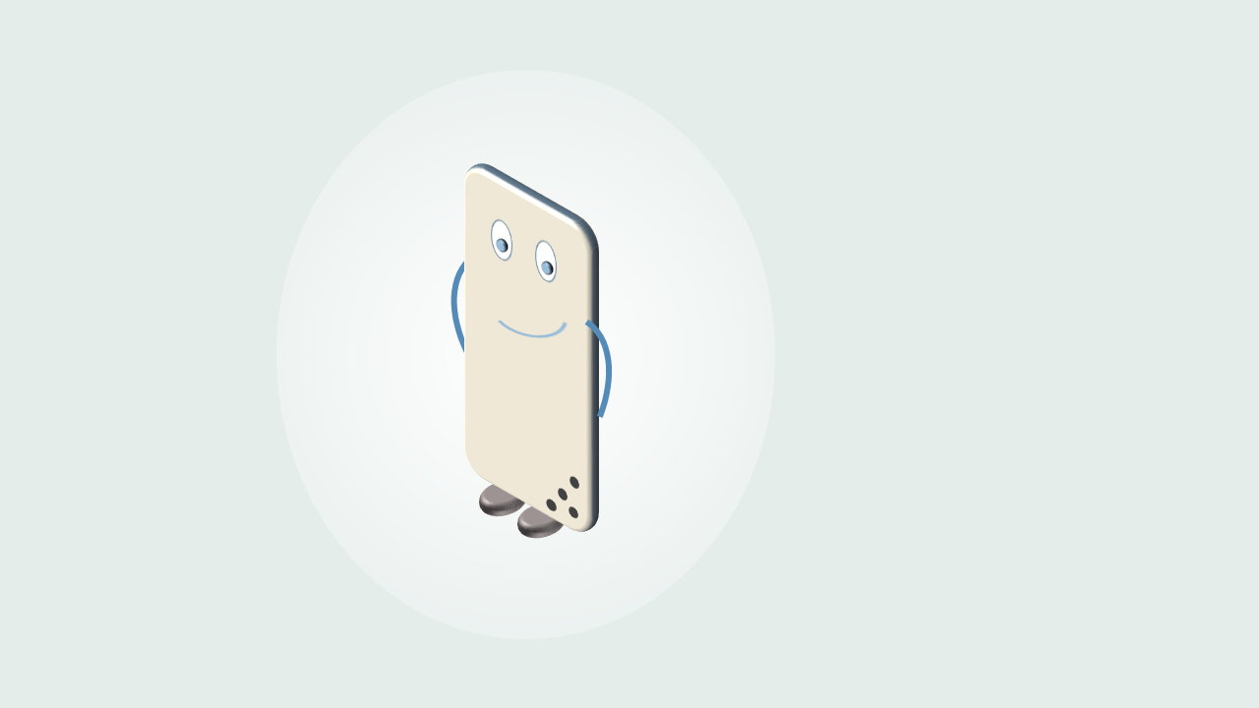
What is a DOMINO?
A DOMINO:
Autonomously produces outputs from a set of inputs
May serve several missions
Can be deployed on a cloud
Is independent from other dominoes infrastructure
Is accountable for its performances
Is interchangeable by another implementation respecting the same interfaces
It provides a valuable SERVICE useful to any Earth Observation ground segment
Example: An image processing service able to transform
TMI (provided by another DOMINO) into images delivered to its customers (or to a DOMINO archive)

Slide 4
What isn’t a DOMINO?
A DOMINO:
is not a toolbox
is not a framework
is not a building block (not a library)

Slide 5
How to define a DOMINO’s scope?
When defining the scope of a domino, the following checks can serve as guidelines
Domino’s scope checks
Domino scope should have “ready to bid” offers by several trusted companies
Domino scope should represent a consistent and autonomous set of features which provide a solution to fulfil functional need
Domino scope should minimise communication interfaces with other dominoes
Domino scope should allow the reuse by several different missions without impact on its definition
Also keeping in mind additional checks
Avoid too big or too small dominoes / Keep a level of homogeneity between dominoes
Keep a consistency in the business skills needed to implement the domino

Slide 6
What are the DOMINO’s properties?
In addition to properties induced by “What is a DOMINO”, each domino
must comply with a set of properties
Domino’s properties
Domino technical definition should not depend on technology choices and/or be impacted by technology evolutions both short and long term
Domino should be able to run on its own infrastructure
Domino should apply basic security guidelines and best practices to protect against outside threats
Domino should comply with cloud computing standards in terms of deployment, monitoring & control, scalability and elasticity
Domino should have well defined interfaces, based on recognised standards
Domino should provide information, such as KPI and IT info, for high level supervision, on a configurable periodic basis

Slide 7
What about the system level?
The Domino-X Ground Segment is made up of several
Dominoes to
Significantly reduce development & integration costs and self-ownership of the System Integrator
Reduce schedule to develop and integrate the GS, including the time to connect each domino, to configure the system, to validate and qualify solutions
Reduce operation costs for the customer, by allowing operation at Domino level
Ease the creation of new industrial actors and the development of partnerships
Accelerate technology innovation
Optimise end to end performance of the GS

Slide 8
What about a complete system ?
A complete system
is built by inter-connecting existing and/or new
DOMINOES
The introduction of a new DOMINO shall minimise impacts on existing ones (loose coupling)

Slide 9
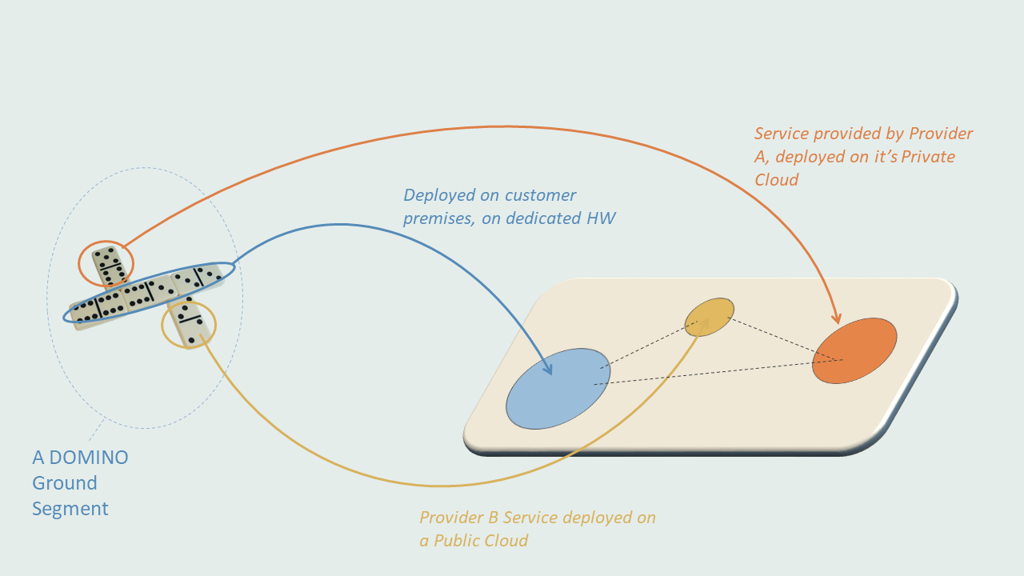
What a future DOMINO GS looks like?

Slide 10
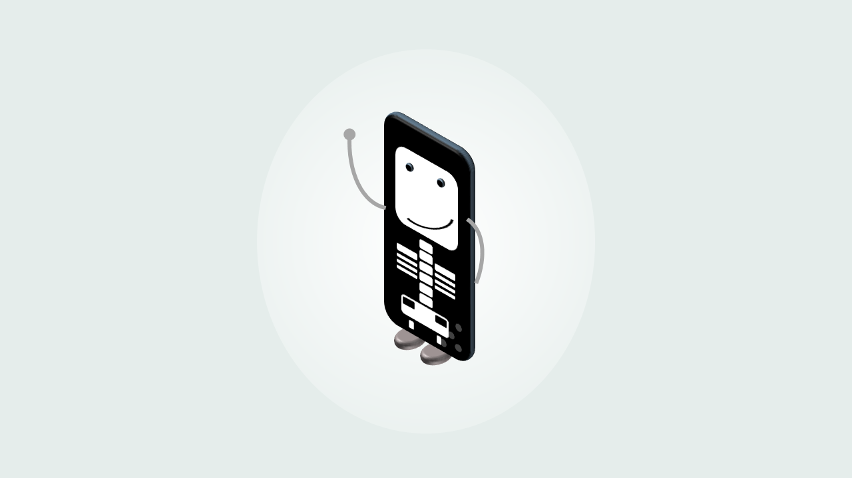
What a DOMINO is made of?
It is not in the scope of the WP 3.1!
But in the scope of others WP for a subset of DOMINOES

Slide 11
Thanks! & feel free to contribute to the project

